Slide 1


Trip Ad Your Travel Buddy
Author Credits
Ajay R
Keerthivasan M
Mohammed Ashiq

Slide 2
Agenda
Trip Ad’s Use case
Technology Stack
Best Practices & Standards followed
Application Workflow
Addon Features
Setup Instructions
Screen Shots

Slide 3

Use Case
Many people love to travel but planning a trip will be a hectic task for most of us.
This Trip Ad Services is Trip management agency, will assist you in making your trip a memorable one…

Slide 4




Technologies Used

Slide 5



Application Workflow - Users
User Registration
Login
View Products
Add To Cart
Review Cart
Check Out
Integrated Online Payment
Invoice Generation

Slide 6

Application Workflow - Admin
Administrator Login
View Products
Add Products
Export Booking Details

Slide 7






Addon Features
Mailing Service
Payment Gateway
PDF Generation
SMS Gateway integration
Excel Export

Slide 8
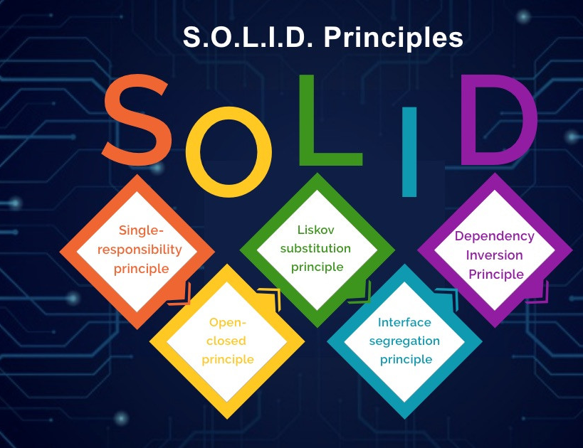
Good Practices & Standards Used
Open Close Principle
Programming through Interfaces
DI & IoC
Plug & Play Approach
Spring MVC Architecture

Slide 9

Setup Instructions
Download the zip from the github repository (https://github.com/AjayR07/TravelAdvisor.git)
Extract the zip file.
Create a database with the name 'trip_ad' or import the sql file inside assets/Sql.
Update the database properties in the application.properties file.
Run 'TravelAdvisorApplication.java' inside src/main/java with your favourite IDE
If you wish to initialize your application with sample data. Uncomment the initializeEnv() function in the 'TravelAdvisorApplication.java’

Slide 10
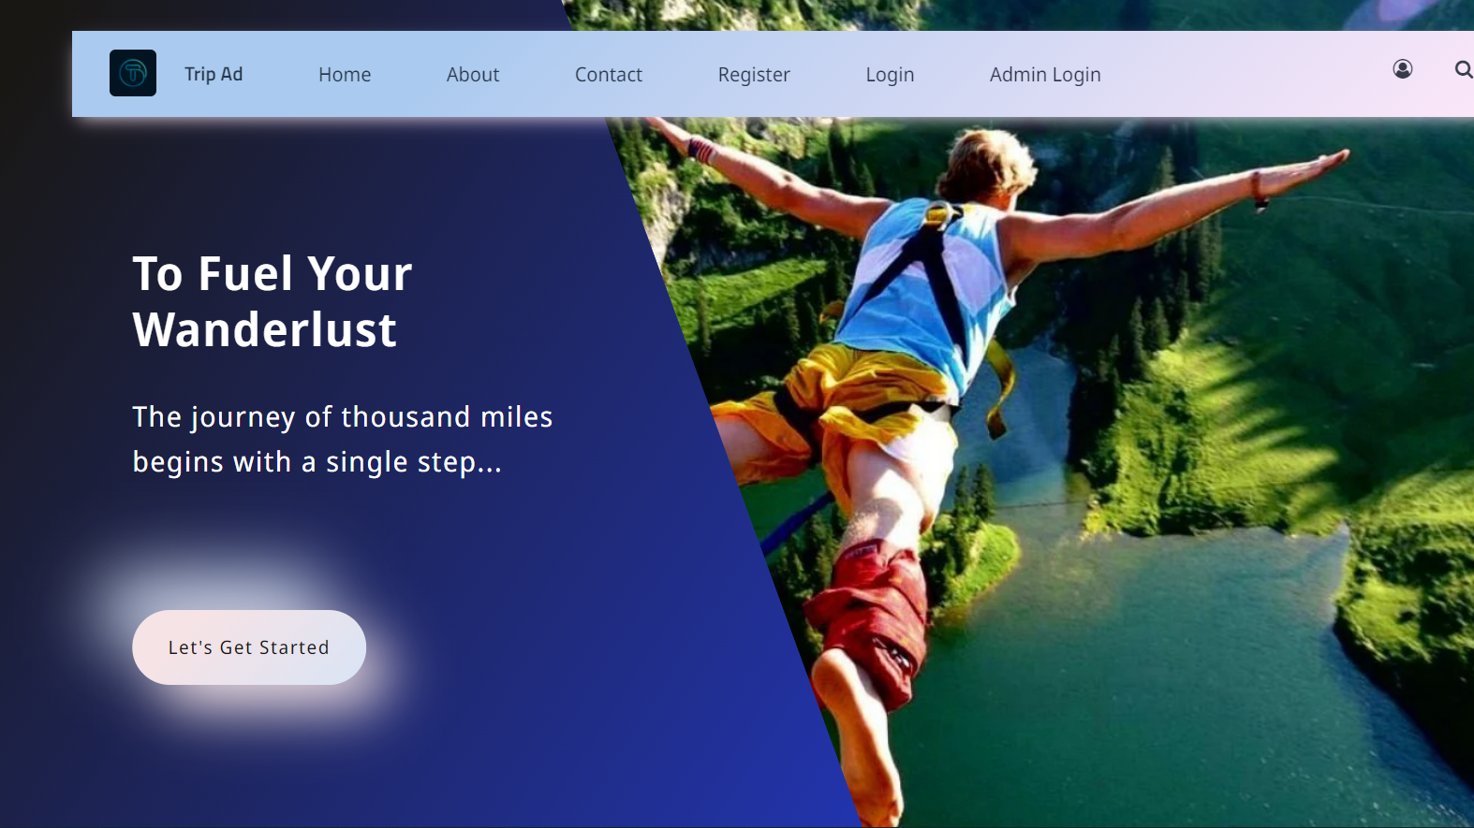
Screenshots

Slide 11
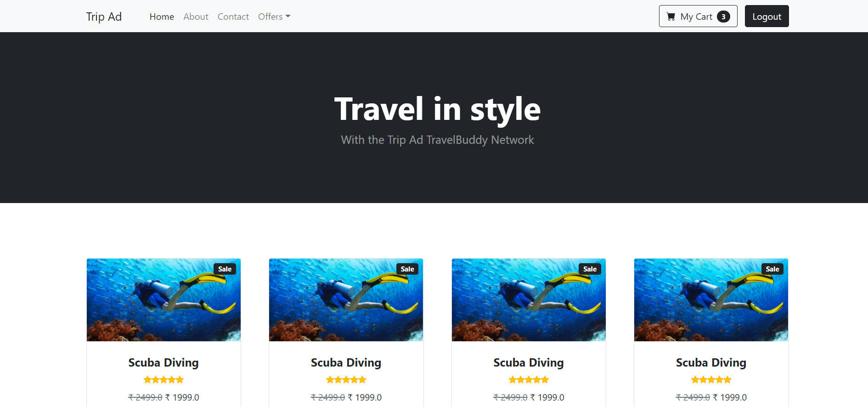
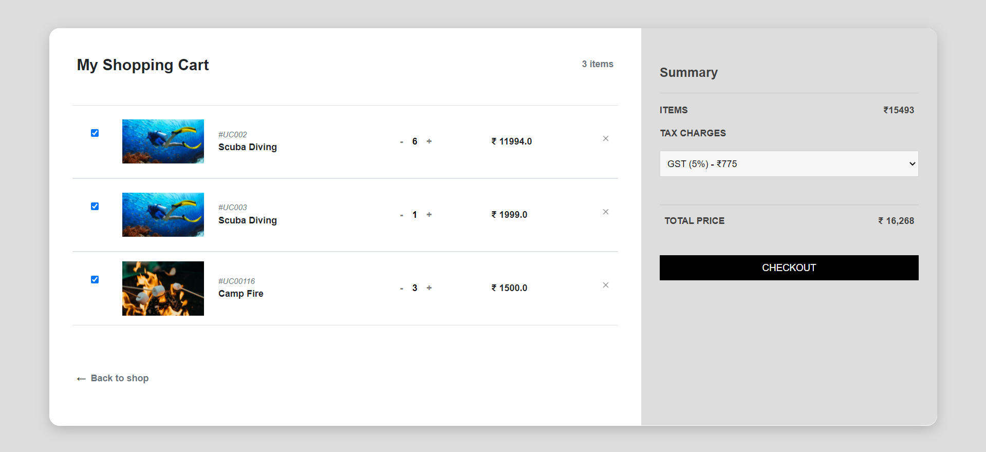

Slide 12

It’s Demo Time

